Slide 1
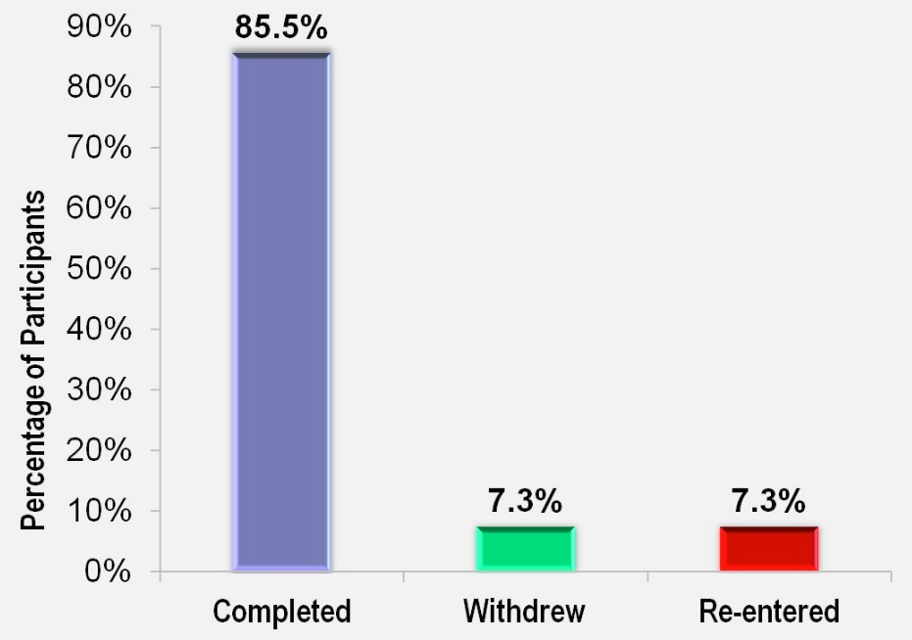
The Every Family Counts AfterCare Program: Examining Outcomes of a Post-Discharge Foster Care Program and Factors Contributing to Successful Reunification
Marsha Davis, B.A., Stephanie Devlin, B.A., Nicole Pearson, Psy.D. LEND Fellows
Jenean Castillo, PhD, Lillian Medina, LCSW, LEND Mentors
Leadership In Neurodevelopmental Disabilities (LEND) at Westchester Institute for Human Development (WIHD) and New York Medical College
Background
Methods
Community Partner
Every Family Counts
Individual case reviews were conducted for those participants who failed to complete the program either due to re-entry or withdrawal.
Of the five children who re-entered the foster care system, four were under three years of age
One of the biggest challenges for the Child Welfare System is sustaining successful reunification of families who continue to have complex and chronic needs after children are discharged from foster care placement. Re-entry rates are of critical importance because they indicate that children are being re-exposed to child abuse, neglect, and/or trauma. The federal expectation is that the re-entry rate after one year of discharge from foster care is no higher than 8.6% (ARCARS, 2005). In 2004, Westchester County DSS reported a re-entry rate of 20%. In response, the Every Family Counts (EFC) AfterCare program was developed at the Westchester Institute for Human Development (WIHD). The purpose of this study is to evaluate the effectiveness of the Every Family Counts AfterCare Program and examine the child, family, and systemic factors that effect permanency and stability over time.
Study Design
Elizabeth Dwyer, Manager I, Program and Policy Westchester County Department of Social Services - Foster Care and Preventative Services Department
Archival record review of data collected via questionnaires administered by program social workers to families who participated in the program between 2009 and 2011. Descriptive statistics and statistical analyses including correlation coefficients were used to discern those factors which most impact successful reunification of foster children with their caretakers, as measured by no re-entry into foster care two years after discharge from the foster care placement.
Results
and had spent an average of 13 months in foster care. The fifth was a 16 year-old who was suspected of substance abuse. Additional findings include:
Four of the five caretakers had a mental health diagnosis; none were receiving treatment (therapy or medication).
Two of the five caretakers were suspected of drug abuse and had co-morbid mental health diagnoses
Five children from three families were withdrawn prior to completion of the program. One family voluntarily withdrew, one family relocated, and the child from the third family was placed in an intensive care management program.
As shown in Figure 1, the re-entry rate for AfterCare program participants in this study was 7.3%. Approximately 86% of participants successfully completed the program while 7% withdrew prior to completion. The average length of participation for families completing the program was 23.4 months.
The following factors were significantly related to re-entry into foster care:
Substantiated CPS calls
Caregiver’s Alcohol & Drug Use
Caregiver Using Substances
Anger Management Services
Domestic Violence Services
Mental Health Services
Marital & Family Therapy
Participants and Setting
Participants included 69 children from 54 families. As displayed in Table 1, the average age of the children in the program was 8.3 years, and their average length of time in foster care was 22.7 months.
AfterCare Services
Case Management
Parent Training
Wrap-Around Services
Family Therapy
Educational Advocacy
Table 1: Participant Demographics
Average Age of Child 8.3 years
Length of Time in Foster Care 22.7 months
Percentage
Gender
Male 54%
Female 46%
Race
AA/Black 41%
Hispanic 23%
Mixed 19%
White 16%
DSS Office
Yonkers 48%
Peekskill 19%
White Plains 16%
Mt. Vernon 13%
Special Education Classification
Yes 53% No 47%
Discussion
The re-entry rate of 7.3% for participants in WIHD’s AfterCare program is below the federal guideline of 8.6% and Westchester County’s requirement of 8%. This positive outcome demonstrates the efficacy of WIHD’s service model in helping families achieve positive and permanent reunification following foster care.
Consistent with previous findings in the literature, these study results suggest that substance abuse and mental health issues play a significant role in re-entry. Such results highlight the importance of:
identifying potential substance abuse and mental health issues among caregivers prior to the onset of AfterCare services;
ensuring caregivers are not only offered
appropriate services but actively participate in
them as well.
Figure 1. Reason for AfterCare Program Termination (N=69)
Objectives
To describe the characteristics of parents and children participating in the WIHD AfterCare Program.
To determine the re-entry rates for participants in the Every Family Counts (EFC) AfterCare Program and compare the results to rates in Westchester County.
To identify factors that affected successful reunification of children in foster care with their caretakers.
1E-06

